Slide 1
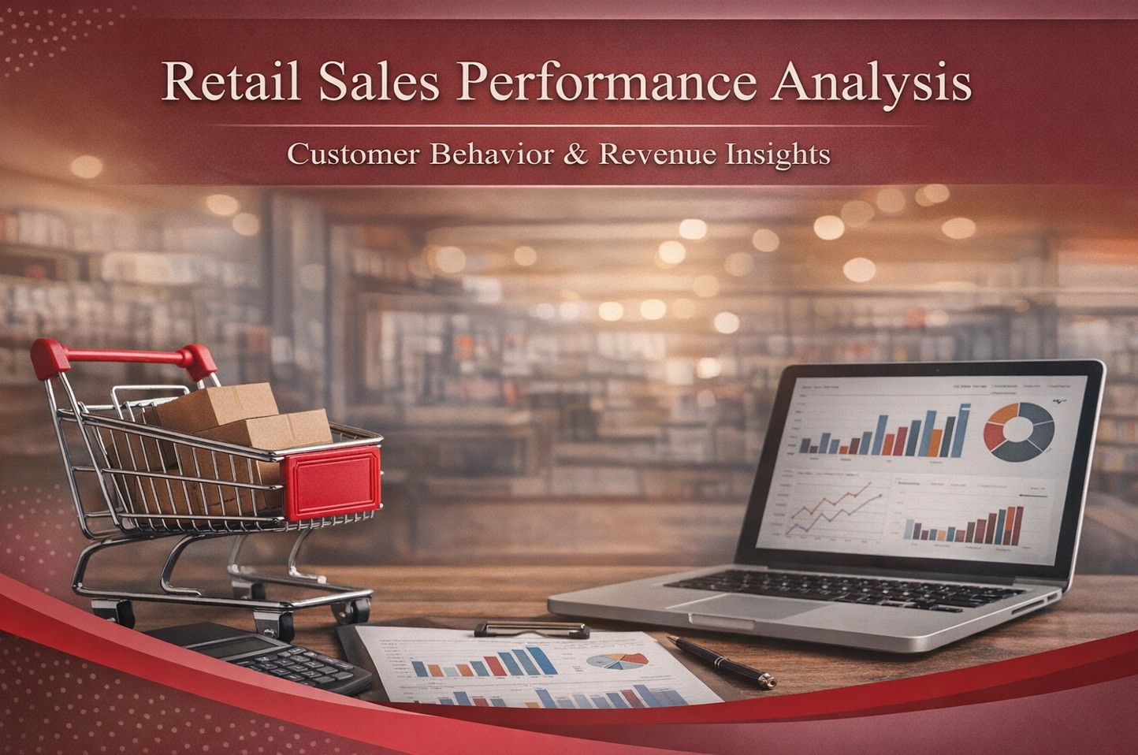
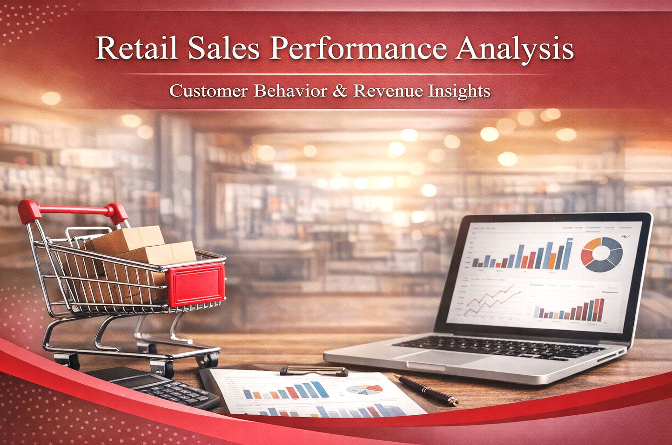
Sahar Mobashertofighi
5 February 2026

Slide 2







About Me
Sahar Mobashertofighi
M.Sc. IT Engineering
aspiring Data Analyst
Kronberg, Germany
www.linkedin.com/in/smobashertofighi
2

Slide 3

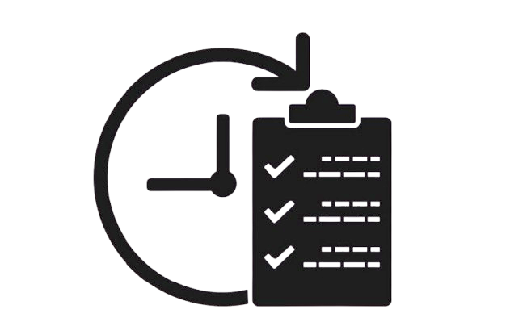
Agenda
1
Project Motivation
Business Context & Stakeholder
Dataset Overview
Analytical Workflow (EDA)
Business Questions & Hypotheses
Dashboard Design & Insights
Business Recommendations
Further Improvements
Conclusion
2
3
4
5
6
7
8
9
3

Slide 4

Project Motivation
Retail companies generate large volumes of transactional data every day
Without analysis, key revenue drivers and customer patterns remain hidden
Understanding who buys, what they buy, and how they pay is critical for growth
Key Question: How can transactional data be transformed into actionable business insights?
4

Slide 5

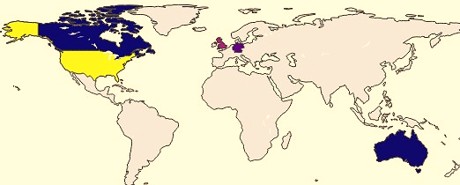

Business Context & Stakeholder
Primary Stakeholder:
Head of Sales & Business Analytics
Mid-sized retail company operating in Germany
5

Slide 6


Business Context & Stakeholder
Stakeholder Responsibilities:
Revenue growth
Sales performance monitoring
Customer behavior analysis
Strategic planning
Stakeholder Objectives:
Increase total revenue
Identify high-value customers
Understand customer purchasing behavior
Optimize payment and sales strategies
Support data-driven planning
6

Slide 7


Dataset Overview
Source: Kaggle – Retail Transactional Dataset
300,000+ real-world retail transactions
Data Scope:
Customer-level and transaction-level records
Covers purchasing behavior, payment choices, and demographics
Key features:
Demographics (Age, Gender, Location) of 86,000+ unique Customers
Product information & categories (5 Categories)
Payment methods (4 Payment Options)
Transaction timestamps
Revenue, ratings, and transaction values
7

Slide 8

Analytical Workflow
Data understanding & cleaning
Feature engineering
Exploratory data analysis (EDA)
Hypothesis-driven analysis
Visualization with power BI
Business recommendations
8

Slide 9


Business Questions & Hypotheses
BQ1: Do frequent customers generate more revenue?
Hypothesis 1: Customers with higher purchase frequency generate significantly higher total spend.
BQ2: Do payment methods influence high-value transactions?
Hypothesis 2: High-value transactions are more likely to occur using specific payment methods.
BQ3: Which age groups drive revenue?
Hypothesis 3: Younger customer segments contribute a disproportionately higher share of total revenue.
9

Slide 10

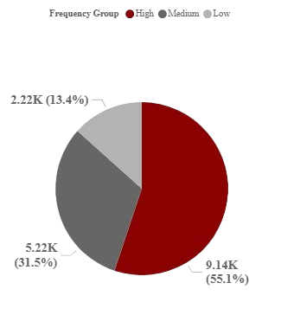
Hypothesis 1 – Purchase Frequency & Revenue
Average Spend by Purchase Frequency Group
Customers with higher purchase frequency generate significantly higher average spending.
Very High frequency customers outperform all other segments, highlighting the importance of retention and repeat purchase strategies
10

Slide 11

Business Insight – Hypothesis 1
Increasing purchase frequency significantly increases customer lifetime value
Retention is more impactful than acquisition alone
Revenue is concentrated among repeat customers
11

Slide 12
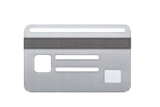
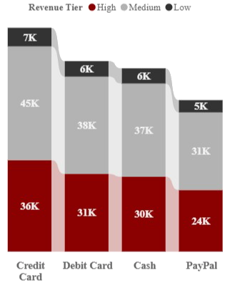
Hypothesis 2 – Payment Method & Transaction Value
Transaction Value Distribution by Payment Method
High-value transactions are not evenly distributed across payment methods.
Customers tend to prefer card-based payment channels for larger purchases, indicating a behavioral preference when transaction value increases
12

Slide 13
Business Insight – Hypothesis 2
Payment preferences correlate with transaction value
Optimizing payment options can encourage higher-value purchases
Payment channels influence customer behavior
13

Slide 14

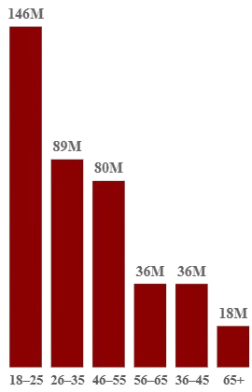
Hypothesis 3 – Age Group Contribution
Revenue Contribution by Customer Age Group
Revenue contribution is not evenly distributed across age groups.
Younger customers generate a disproportionately higher share of total revenue, highlighting them as a key growth-driving segment
14

Slide 15
Business Insight – Hypothesis 3
Younger customers show higher purchasing activity
Targeted marketing toward these segments can maximize ROI
Age-based segmentation improves campaign efficiency
15

Slide 16


Power BI Dashboard – Interactive Analysis
KPI cards: Revenue, AOV, Transactions
Trend analysis over time
Customer and payment segmentation
Interactive filters (Year, Age Group, Category)
16

Slide 17

Business Recommendations
Invest in loyalty programs to increase purchase frequency
Promote preferred payment methods for high-value transactions
Focus marketing on high-performing age segments
Use dashboards for continuous monitoring
17

Slide 18

Further Improvements
Add profit margin and cost data
Build customer lifetime value (CLV) models
Apply predictive analytics
Integrate real-time sales data
18

Slide 19


Conclusion
Data-driven analysis validates key business hypotheses
Customer segmentation reveals actionable revenue drivers
Interactive dashboards support faster, smarter decisions
19

Slide 20

GitHub Repository
Scan to view the GitHub repository
20

Slide 21


